Slide 1



PDF Merger
Merge PDF files seamlessly in your browser
Presented by: Mozahid Islam

Slide 2
PDF Merger
PDF Merger is designed to overcome the common challenges of existing PDF tools, offering a robust, user-friendly, and accessible solution.
100% Client-Side Merging: All processing happens in your browser, ensuring privacy and speed.
Intuitive Interface: Features simple drag & drop functionality and a clear file browser for effortless use.
Lightweight & Responsive: Designed for a smooth experience across various devices without consuming excessive resources.
Completely Free & Private: Enjoy full functionality without hidden costs or concerns about data security.

Slide 3
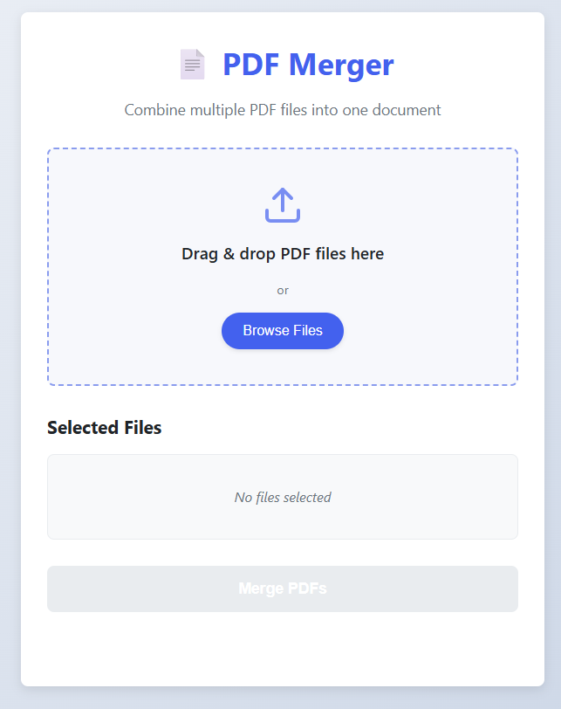
🧪 Overview
PDF Merger design and key functionalities:
Drag & Drop Area: Seamlessly upload files with a simple drag-and-drop motion.
File List: Clearly visualize your selected PDFs before merging.
Merge Button: Initiate the merging process with a single, prominent click.
Progress Bar: Monitor the real-time progress of your PDF merge operation.

Slide 4

How It Works
01
02
Frontend Foundation
Leveraging pdf-lib
Built entirely with standard web technologies: HTML provides the structure, CSS handles the styling and responsiveness, and JavaScript orchestrates the core logic.
The heavy lifting of PDF manipulation is powered by pdf-lib, a robust JavaScript library that enables in-browser PDF creation and modification without server-side interaction.
03
04
User Interaction to Action
Instant Download
Upon user file selection (either via drag & drop or file browser), JavaScript triggers the pdf-lib merging functions, processing the PDFs directly in the client's browser.
Once the merge operation is complete, the newly combined PDF is immediately offered to the user as a download, providing a seamless and private experience.

Slide 5
Conclusion
"PDF Merger embodies the power of simple ideas to create impactful, everyday tools. Built with foundational web technologies, it stands as a testament to efficient, user-centric development."

Slide 6

THANK YOU

